Slide 1

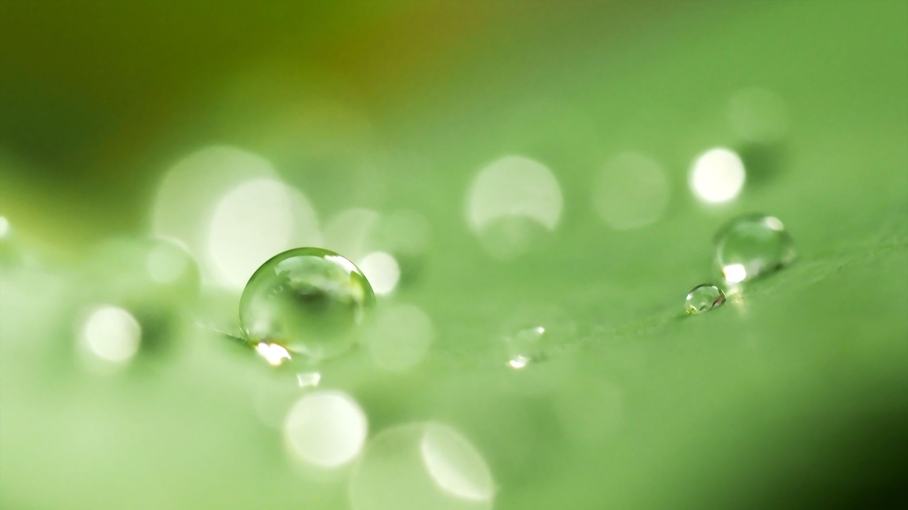

Plants
For parents
Thank you for supporting your child’s learning in science.
Before the session:
Please read slide 2 so you know what your child is learning and what you need to get ready.
As an alternative to lined paper, slide 6 may be printed for your child to record on.
During the session:
Share the learning intentions on slide 2.
Support your child with the main activities on slides 3 - 6, as needed.
Slide 7 is a further, optional activity.
Slide 8 has a glossary of key terms.
Reviewing with your child:
Slide 9 gives an idea of what your child may produce.
How does water travel to different
parts of a plant?
Year 3
Age 7 - 8

Slide 2
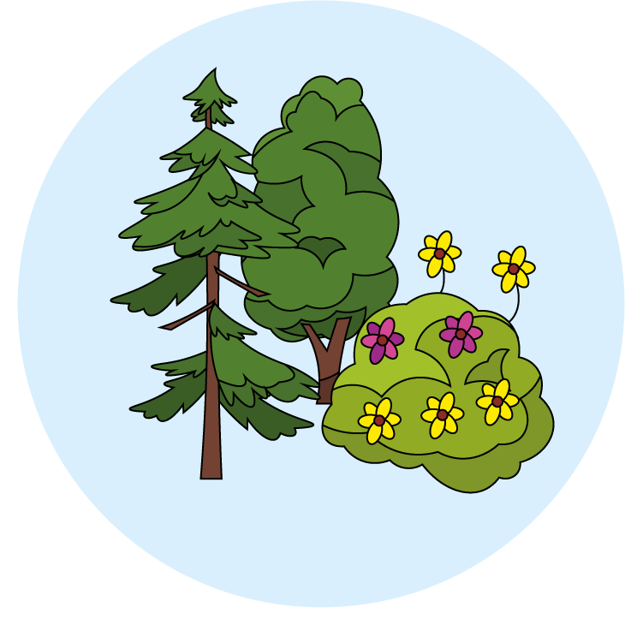
Plants
How does water travel to different parts of a plant?
Key Learning
Many plants, but not all, have roots, stems/trunks, leaves and flowers/blossom.
The roots absorb water and nutrients from the soil and anchor the plant in place.
The stem transports water and nutrients/minerals around the plant and holds the leaves and flowers up in the air to help with photosynthesis, pollination and seed dispersal.
Activities (pages 3-6): 40 mins, plus waiting time between observations.
You will need:
Water
Food colouring
Celery or white carnations
Clear containers/glasses
Table knives
Chopping board
Find out more… (page 7):
You may like to slice the stem, from the bottom to halfway up, to observe the journey of the water through it.
I can…
observe the effect of putting cut white carnations or celery in coloured water.

Slide 3
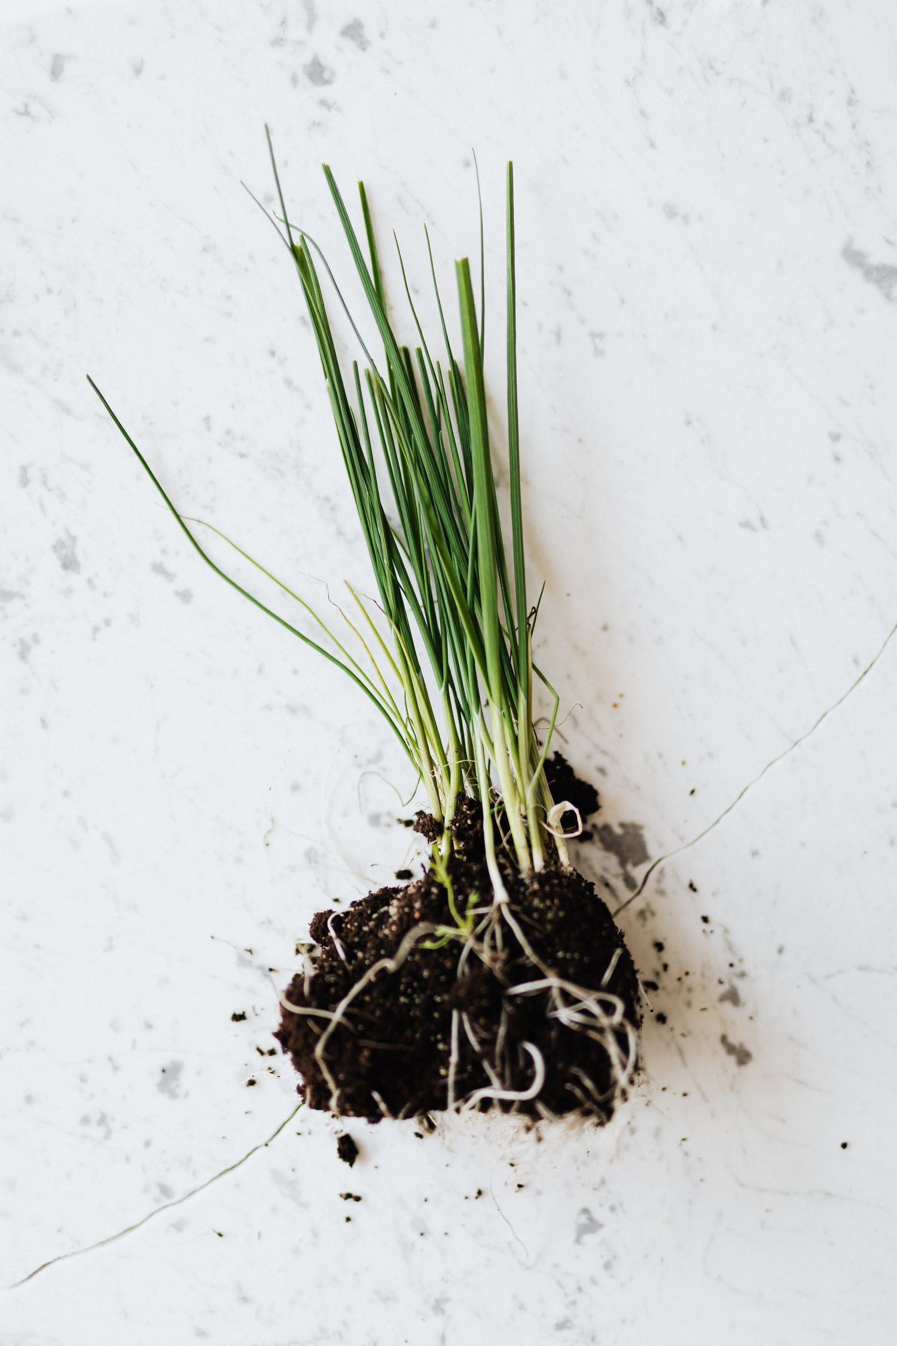
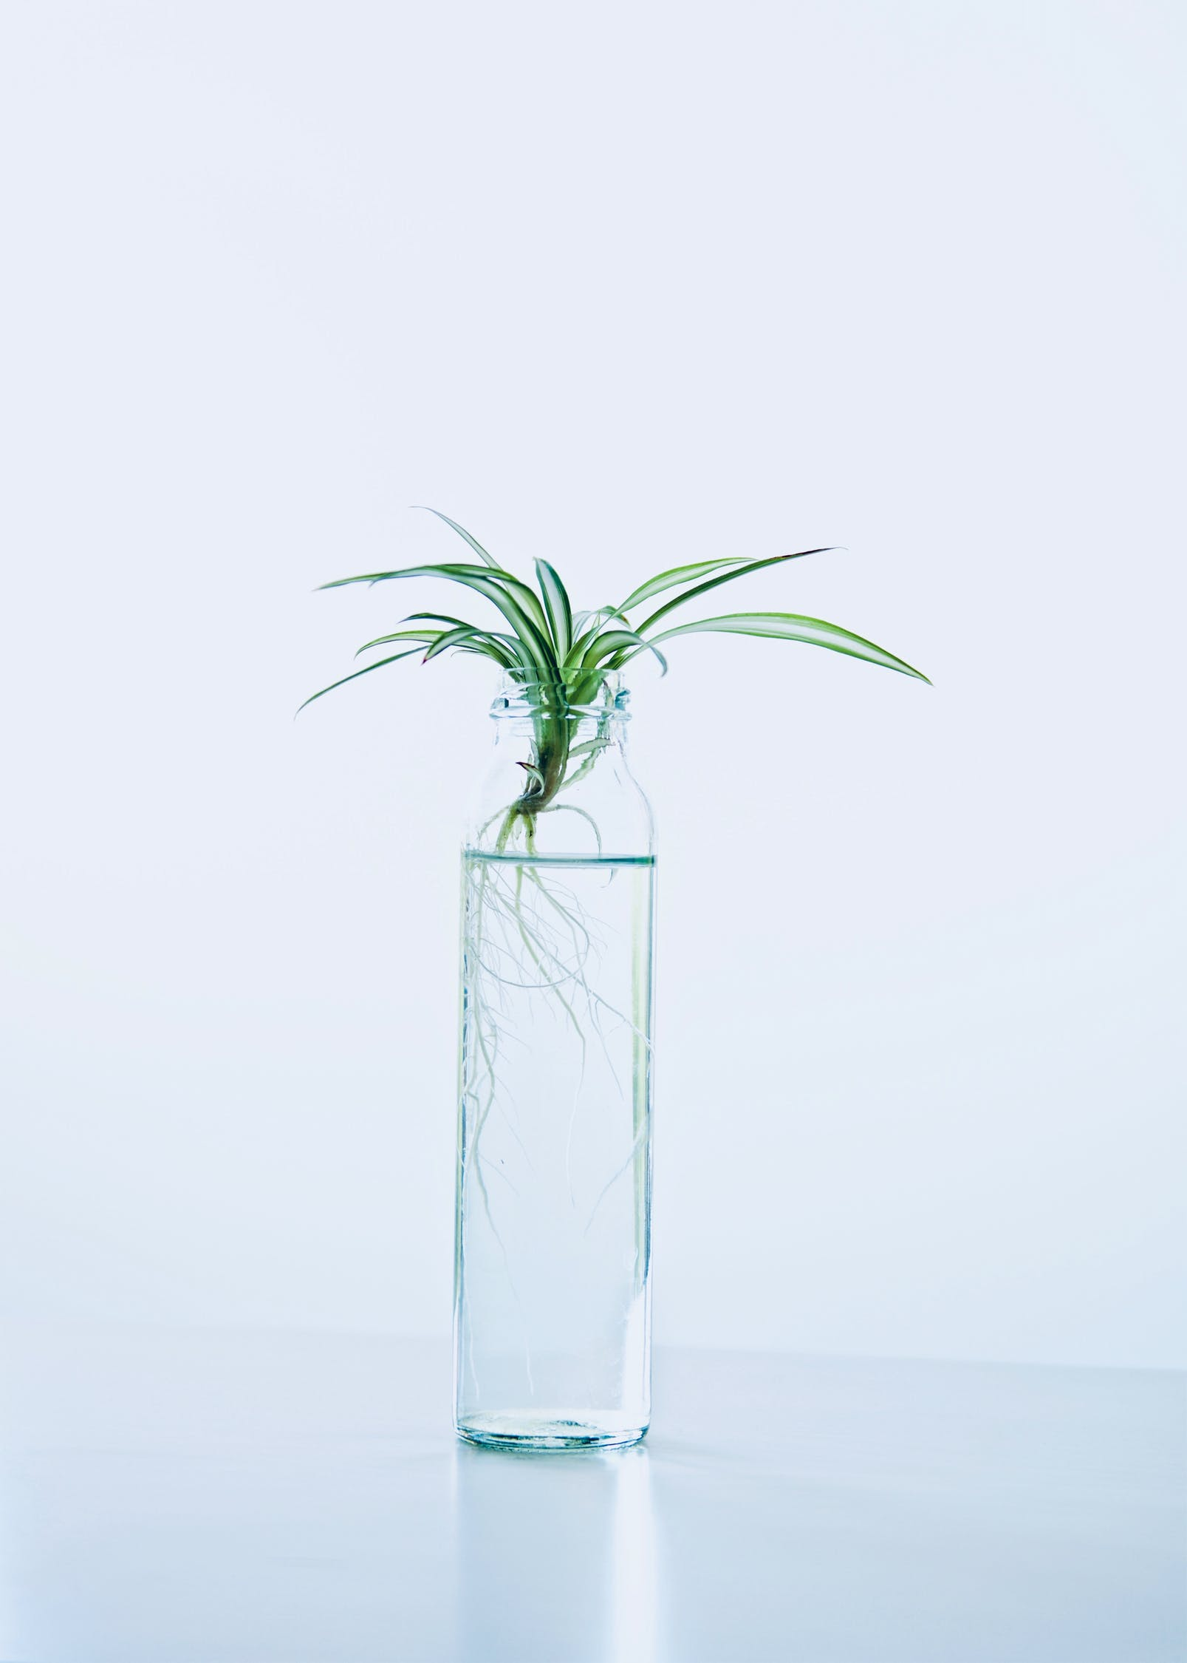
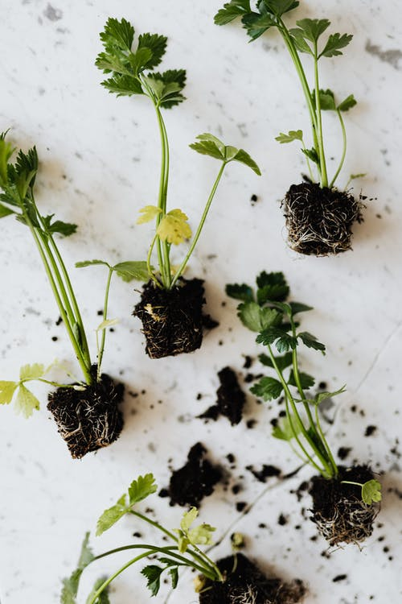
Explore, review, think, talk…
What do you already know about how plants get water?
(5 minutes)
What is the purpose of the root system?
Why do plants need to transport water?
How do you think plants transport water?
The water is absorbed by the roots of a plant.
It then moves into tubes that carry the water up the plant to the leaves and flowers.

Slide 4
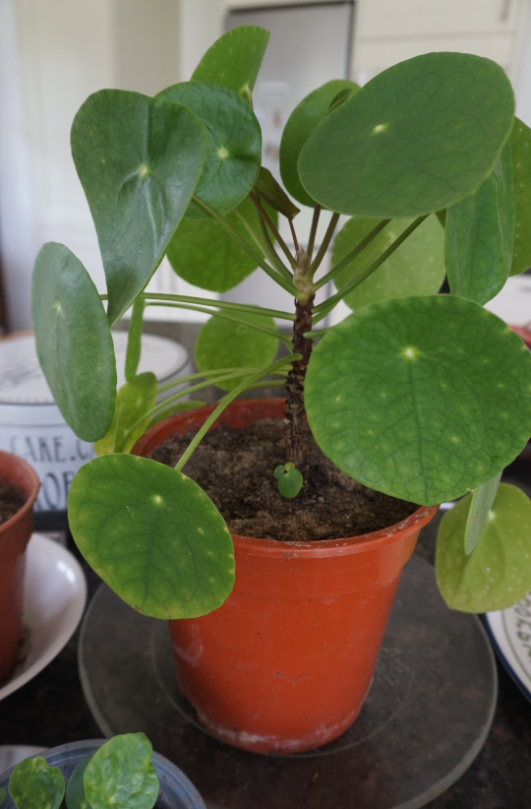
Watch, read, listen…
How can we explore the way water travels through a plant?
(page 4-6: 15 – 20 minutes, plus waiting time between observations)
Watch this BBC Teach clip exploring how water can travel even when a cut flower has no roots!
https://www.bbc.co.uk/teach/class-clips-video/science-ks1-ks2-ivys-plant-workshop-how-does-water-get-from-the-roots-to-the-leaves/zdtfjhv
Why do you think they used white flowers?
Read this article to find out more about how water travels through a plant and why it is needed. https://www.dkfindout.com/uk/animals-and-nature/plants/how-plants-make-food/

Slide 5
Ask an adult to work with you.
Watch this video explaining how to investigate the way water moves through a plant.
https://www.youtube.com/watch?v=KIug9Foou3s
If you can, use celery or white carnations (they seem to work the best!) and red or blue food colouring.
I can observe the effect of putting cut white carnations or celery in coloured water.
When you have set up the experiment, make regular observations.
For example, you might want to take photographs, or make sketches every couple of hours.
Where does the change start to happen?
How are the petals of the flower are changing?
Does the food colouring affect any other parts of the the plant?
Why do you think this might be?

Slide 6
Once the investigation has been set up decide:
How often you will observe and record any changes?
Remember to observe at regular intervals. Will that be every 30 minutes? Every hour? Every two hours?
Which parts of the plant changed colour?
Is the colour stronger in certain parts of the plant?
Why do you think that is?
I can observe the effect of putting cut white carnations or celery in coloured water.
Length of time | Describe the carnation/celery | Draw the carnation/celery

Slide 7
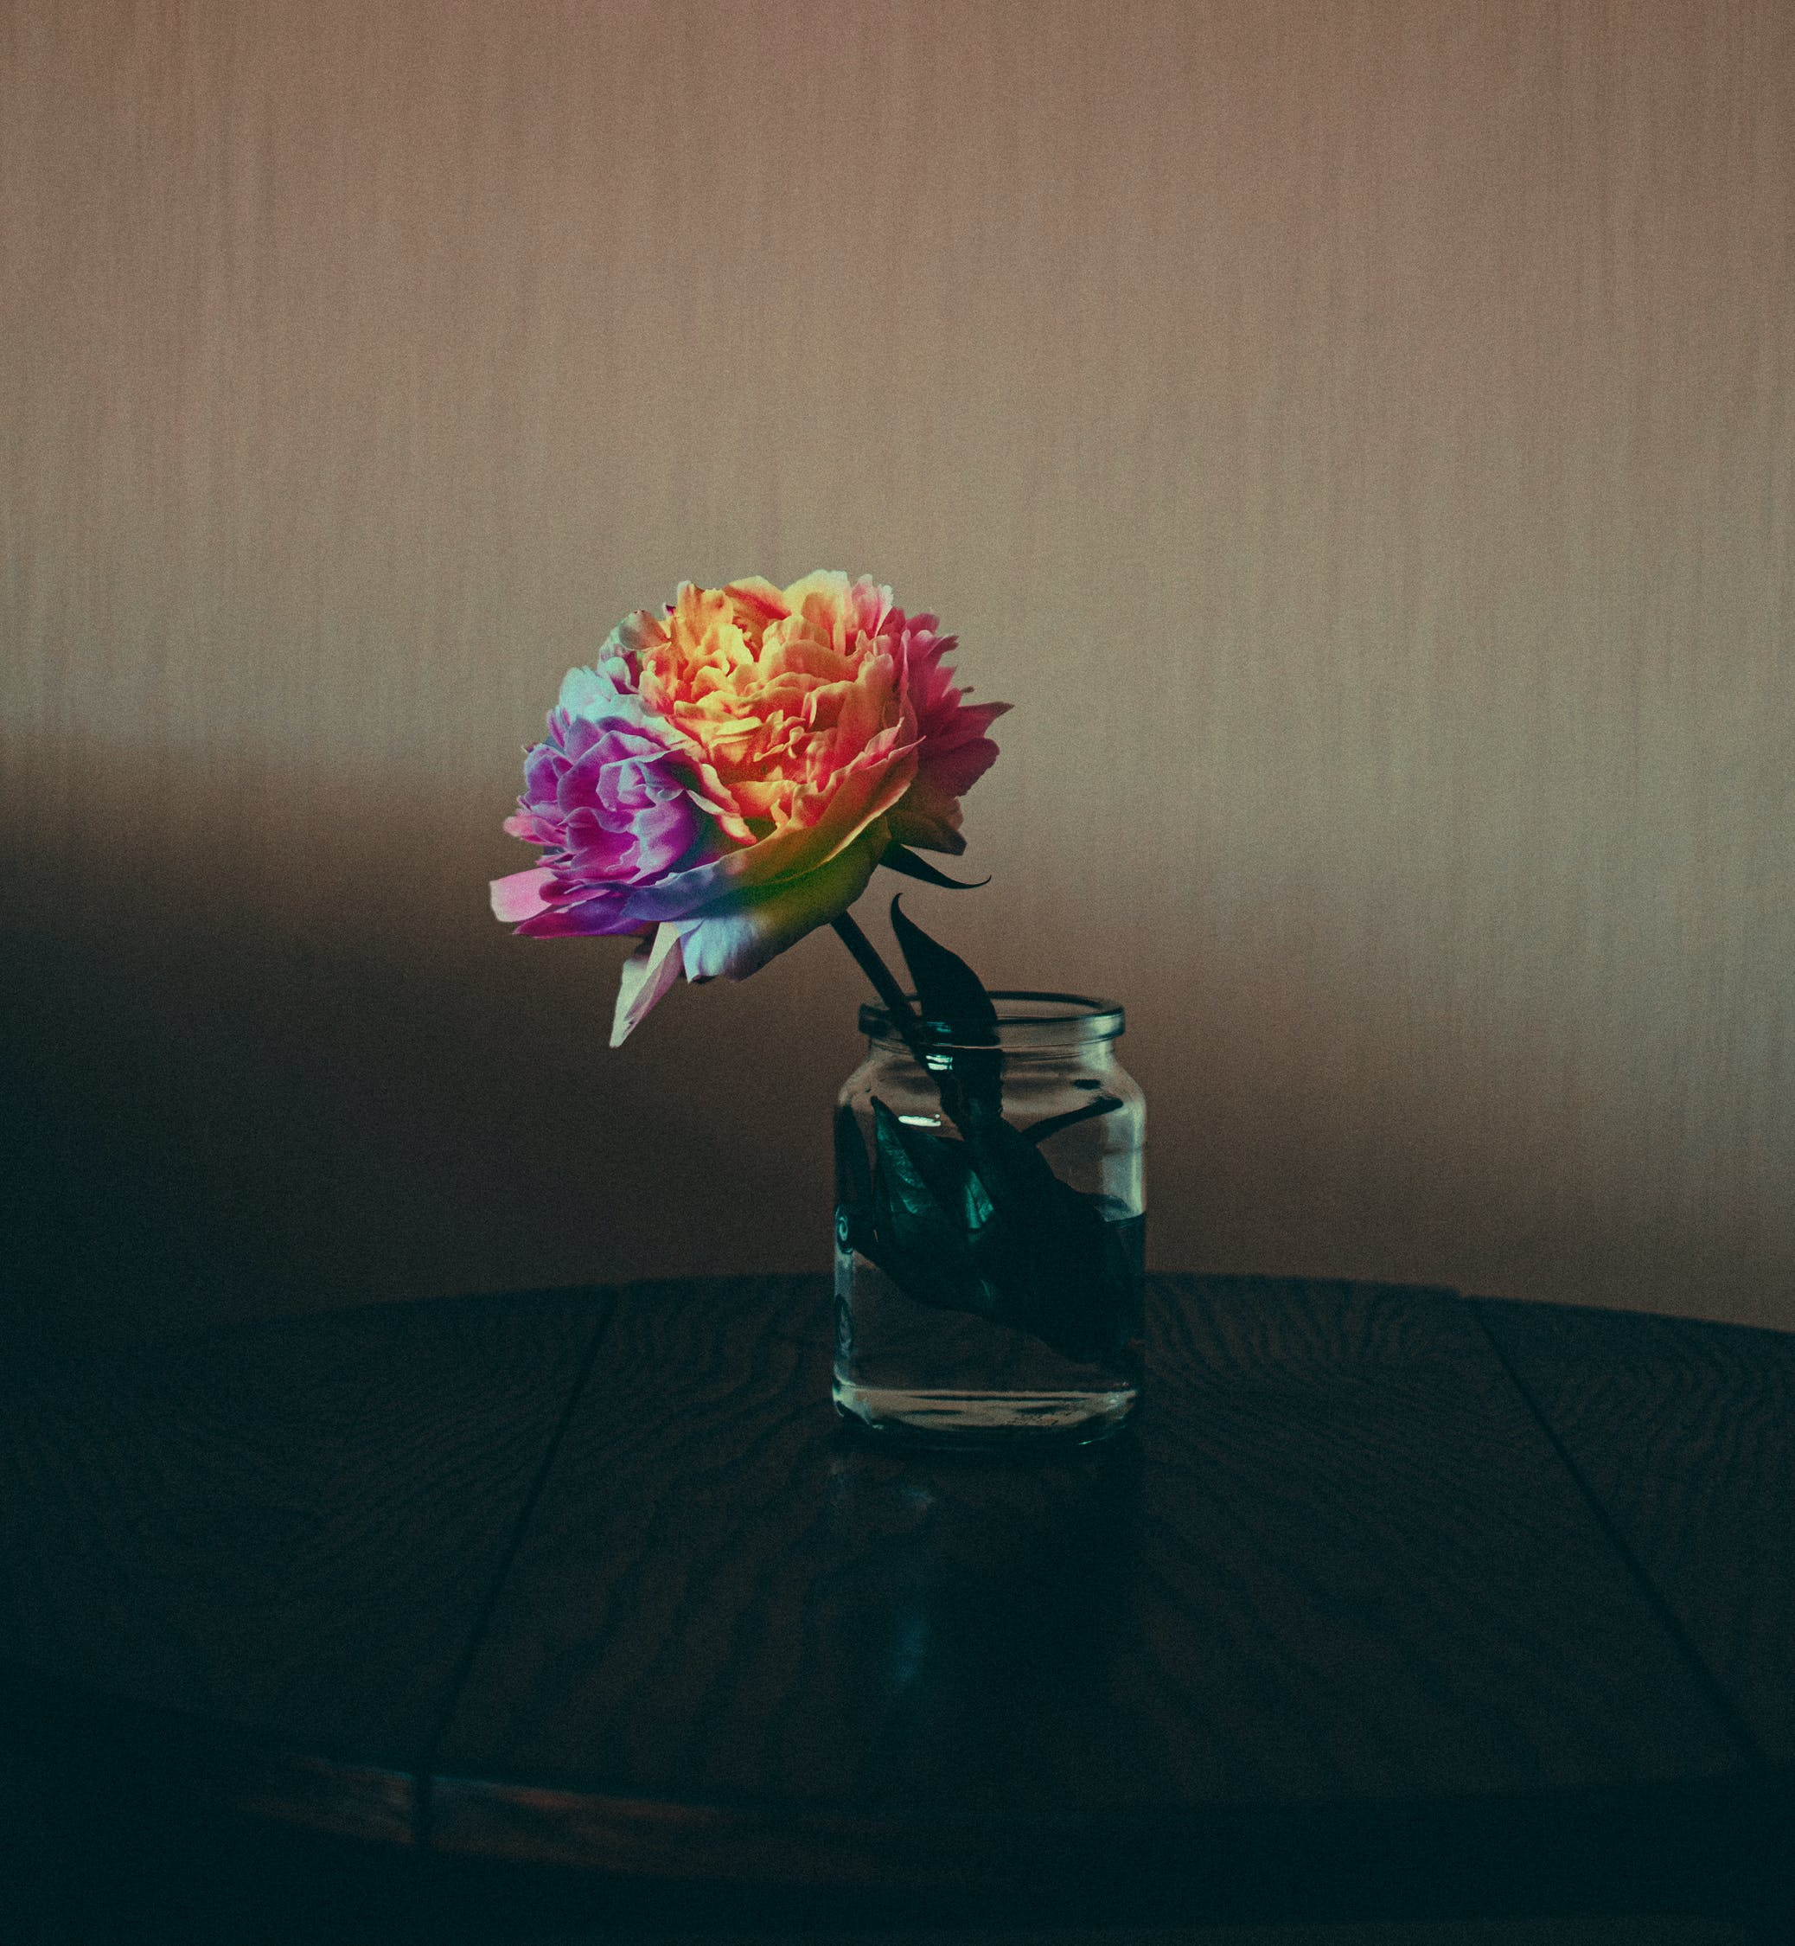
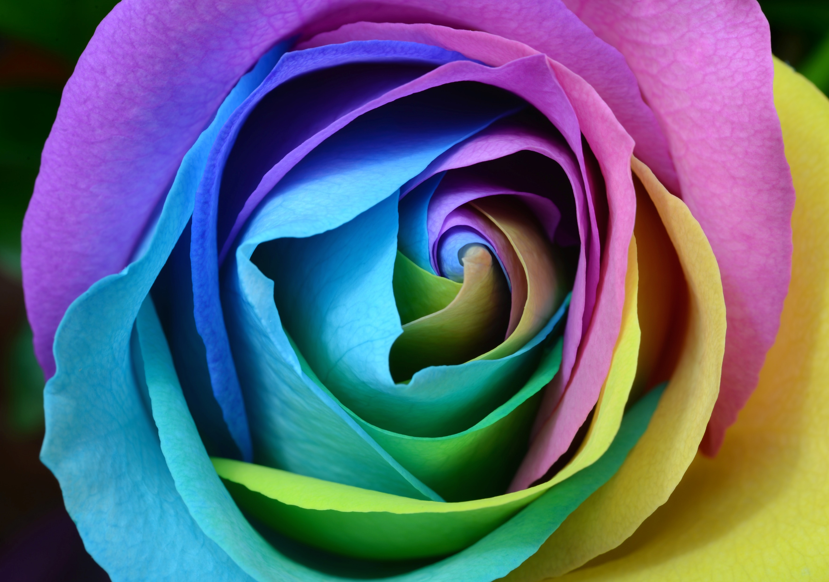
Taking it further…
Just how creative can you get?
(10-20 minutes, plus waiting time)
How can you make your flower take up two colours?
Carefully, with adult supervision, split the stem in two. Place one half in one coloured dye and the other half in another colour.
What happens when you use a naturally coloured red carnation? Does the colour change?
If you need some help, watch the video below
https://www.youtube.com/watch?v=RVBueIzlR6Y
Is it possible to make a purple coloured rose? Consider how you could mix your food colouring to create other colours.
Now can you create a rainbow carnation for the NHS?

Slide 8
Glossary of terms
Root: A root is a part of a plant that grows downward.
Stem: A stem is a part of a plant that transports water and nutrients from the roots to the buds, leaves and flowers.
Transport: A transport system carries things from one place to another place. In plant, the stem helps to transport water and nutrients from the roots to the leaves and flowers.
Photosynthesis: Photosynthesis is the process by which leaves convert sunlight, water and carbon dioxide into food for the plant.
Nutrient: A nutrient is a substance that is needed for healthy plant growth, development and functioning.
8

Slide 9
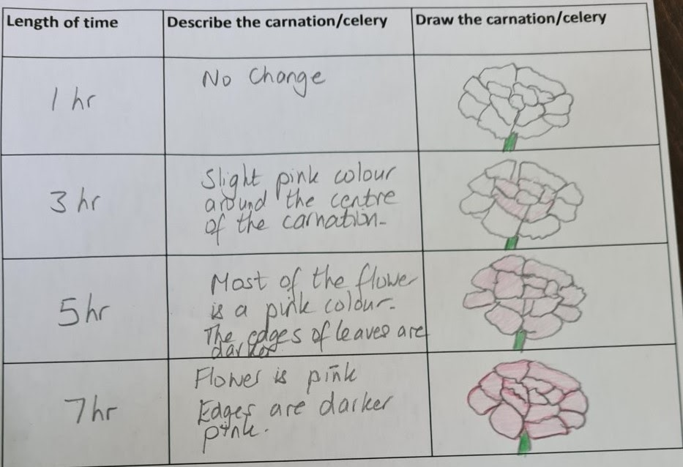
Possible learning outcome for reviewing your work: I can observe the effect of putting cut white carnations or celery in coloured water
Which parts of the plant changed colour?
Can you share the journey of the food colouring with someone else in your home?
Ensure you use the scientific words.
For example:
‘The coloured water travelled up through the roots and up the stem.’
Is the colour stronger in certain parts of the plant?

